Slide 1
Unit ‘4’ (Part 2) Digital Signatures
Prepared by: Abhishek Dewan
Lecturer Cryptography Trinity International College

Slide 2
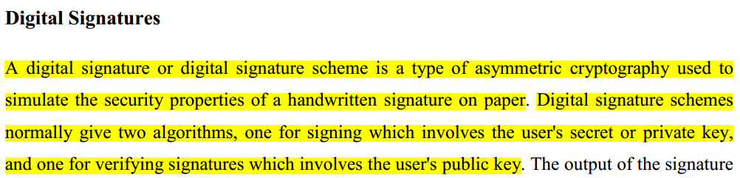
Digital Signatures

Slide 3
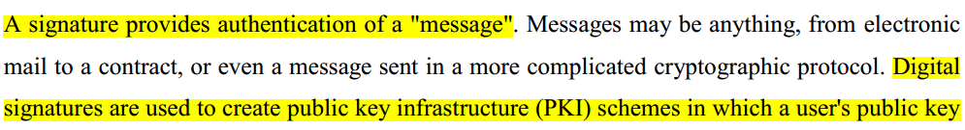

Slide 4
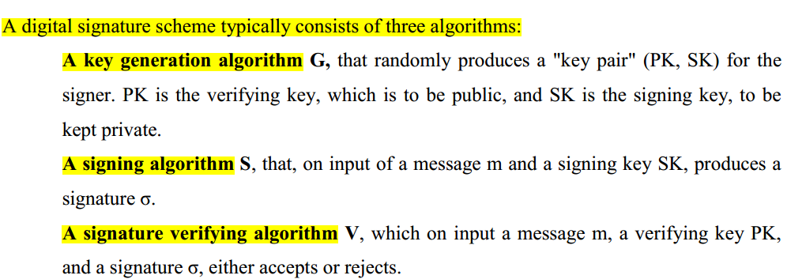
Components of Digital Signature

Slide 5
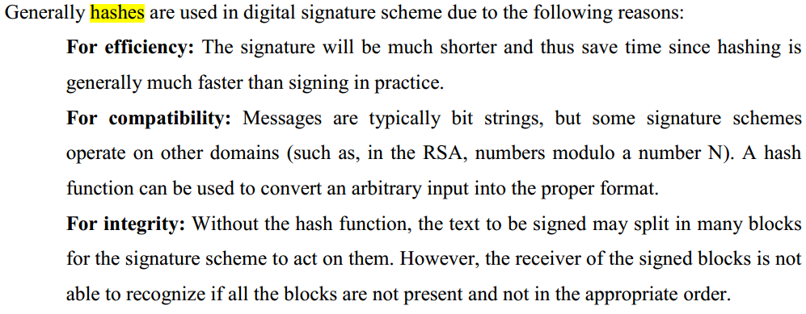
Hash

Slide 6
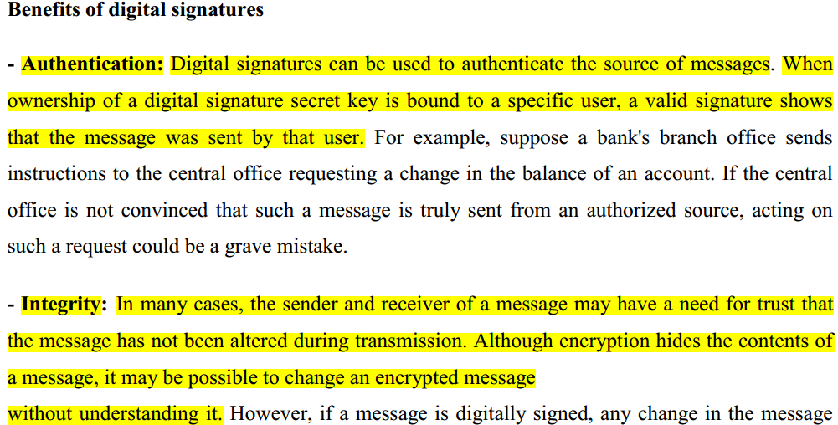
Benefits of Digital Signature

Slide 7
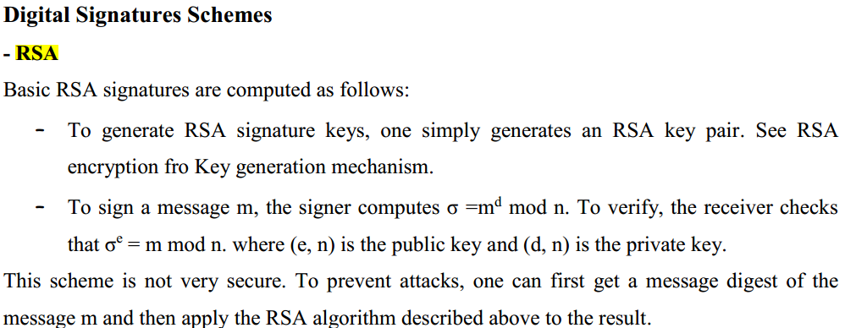

Slide 8
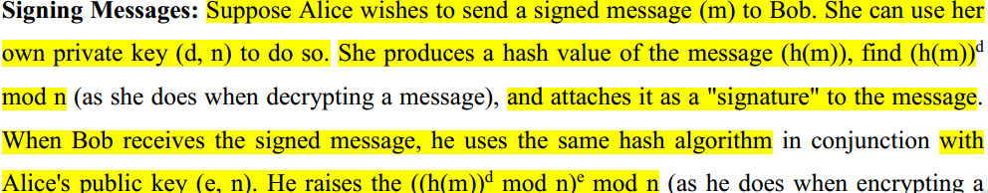

Slide 9
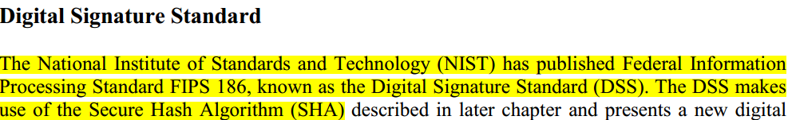

Slide 10
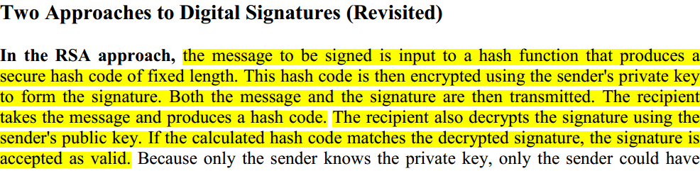
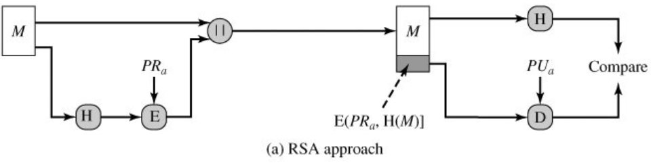
Digital Signature in RSA
Hash Value

Slide 11
Digital Signature in Digital Signature Standard(DSS)
The DSS approach also makes use of a hash function.
The hash code is provided as input to a signature function along with a random number k generated for this particular signature.
The signature function also depends on the sender's private key (PR_{a}) and a set of parameters known to a group of communicating principals.
We can consider this set to constitute a global public key (PU_{G}).
The result is a signature consisting of two components, labeled s and r.

Slide 12
At the receiving end, the hash code of the incoming message is generated. This plus the signature is input to a verification function.
The verification function also depends on the global public key (PU_{G})as well as the sender's public key (PUa), which is paired with the sender's private key.
The output of the verification function is a value that is equal to the signature component r if the signature is valid.

Slide 13
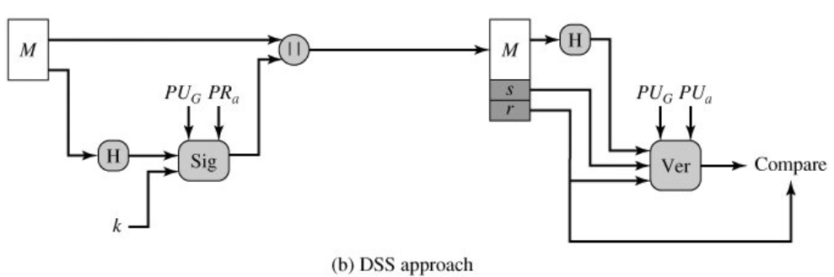
Digital Signature in DSS

Slide 14
Steps involved in DSS:
Generation of keys i.e., public and private keys for the source.
Creation of digital signature by the source for a message.
The receiver verifies the digital signature.

Slide 15
1.Generation of Global Public Key
Find a prime number p such that 2^{L-1} < p < 2^{L}, where L is an integer between 512 and 1024 i.e., 512 <= L <= 1024.
Find another number q which is a prime divisor of (p-1).

Slide 16
Compute: g = h^{(p-1)/q} mod p, where, h is an integer between 1 < h < p-1 and g should greater than 1 or h^{(p-1)/q} mod p>1.

Slide 17
2.Finding the user Private & Public Key
The private key, x is any random number such that 0 < x< q.
The public key, y = g^{x} mod p

Slide 18
3. Generating the Signature
Finding the components of signature s and r.
r = (g^{k} mod p) mod q
s = [k⁻¹ {H(M) + x*r}] mod q where k is an integer such that 0 < k <q.
Signature= (r, s)

Slide 19
4. Verifying the Signature
Let M’, r’, and s’ be the message and signature components respectively received corresponding to M, r, and s.
To verify the signature is valid or not, first the following condition needs to be checked: 0 < r’ < q and 0 < s’ < q

Slide 20
If any of the above conditions is not met, the signature is considered invalid and is therefore discarded;
otherwise, if both conditions are met, the following parameters are computed:

Slide 21
v = [(g^{u1} y^{u2}) mod p] mod q u1 = [H(M)w] mod q u2 = (r’) w mod q w = (s’)⁻¹ mod q Test: v = r’
If v = r’, the signature is correct; otherwise, the data or message has been altered.

Slide 22
Direct Digital Signature
There are only two parties involved in the passing of the signed information: the sender and the receiver.
Direct digital signatures only require these two entities because the receiver of the data (digital signature) knows the public key used by the sender.
And the sender of the signature trusts the receiver not to alter the document in any way.

Slide 23
Arbitrated Digital Signature
Implementing an arbitrated digital signature invites a third party into the process called a "trusted arbiter“.
The role of the trusted arbiter is usually twofold: first this independent third party verifies the integrity of the signed message or data.
Second, the trusted arbiter dates, or time-stamps the document, verifying receipt and the passing on of the signed document to its intended final destination.

Slide 24
Message Authentication
It is a mechanism or service used to verify the integrity of a message.
It assures that data received are exactly as sent by the real sender.

Slide 25
Message Authentication Functions
Hash function: A function that maps a message of any length into a fixed-length hash value, which serves as the authenticator
Message encryption: The ciphertext of the entire message serves as its authenticator
Message authentication code (MAC): A function of the message and a secret key that produces a fixed-length value that serves as the authenticator

Slide 26
Message authentication code (MAC)
An alternative authentication technique involves the use of a secret key to generate a small fixed-size block of data, known as a cryptographic checksum or MAC, that is appended to the message.
This technique assumes that two communicating parties, say A and B, share a common secret key K.
When A has a message to send to B, it calculates the MAC as a function of the message and the key:
MAC = MAC(K, M) where
M = input message
C = MAC function
K = shared secret key
MAC = message authentication code
The message plus MAC are transmitted to the intended recipient.

Slide 27
The recipient performs the same calculation on the received message, using the same secret key, to generate a new MAC.
The received MAC is compared to the calculated MAC.
If we assume that only the receiver and the sender know the identity of the secret key, and if the received MAC matches the calculated MAC, then
The receiver is assured that the message has not been altered.

Slide 28
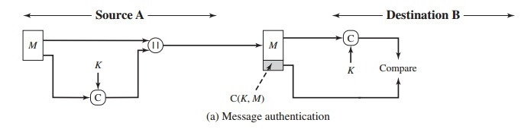

Slide 29
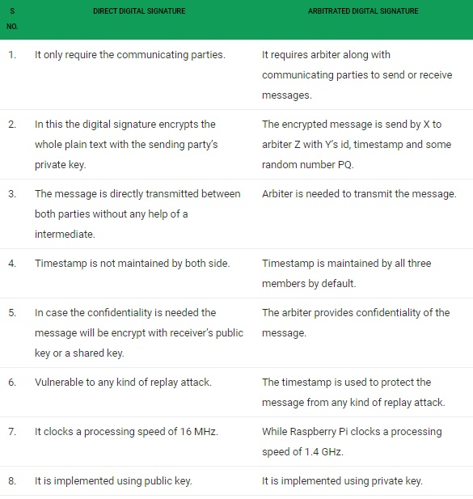

Slide 30
End of Unit ‘4’ (Part 2)

